Slide 1



Mastering Ethereum
Sriram
Technology of Trust

Slide 2

Course Objectives
After completing this module, you should be able to:
Apprehend another Blockchain platform: Ethereum
Perceive the Ethereum Ecosystem
Understand how mining works in Ethereum
Learn Solidity programming language

Slide 3


Introduction to Ethereum

Slide 4

What is Ethereum?

Slide 5
Simply put, while Bitcoin can be described as a Digital money.
Ethereum is a decentralized platform that allows for Smart contract, which is a highly programmable digital money

Slide 6



Ethereum
Ethereum was conceptualized by Vitalik Buterin in November 2013
Ethereum is a distributed public blockchain network
The key idea proposed was the development of a Turing-complete language that allows the development of
smart contracts for blockchain and decentralized applications
Ethereum aims to enable innovations in four key areas:
Currency Issuance
Decentralized Autonomous Organizations (DAO)
Smart Contracts
Smart Property

Slide 7


Comparison between Bitcoin & Ethereum
 | Bitcoin | Ethereum
Concept | Digital money | World Computer
Founder | Satoshi Nakamoto(unknown) | Vitalik Buterin and team
Scripting language | Turing incomplete | Turing complete
Release date | Jan 2009 | July 2015
Coin Release Method | Early mining | Through ICO
Average block time | ~10 minutes | ~12-15 seconds

Slide 8
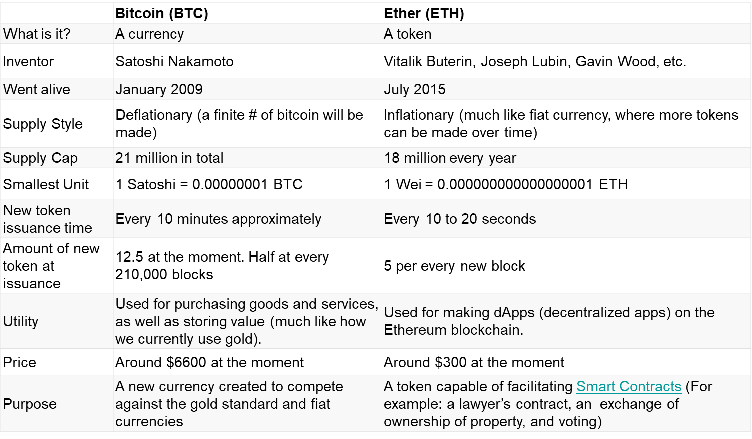
Comparison between Bitcoin & Ethereum..

Slide 9
What do you think about Ethereum?
Ethereum is an open-source, public, Blockchain-based distributed computing platform and operating system featuring smart contract (scripting) functionality
Modified version of Nakamoto consensus via transaction-based state transitions
Cryptocurrency Token – Ether
Ether can be transferred between accounts and used to compensate participant mining nodes for computations performed
EVM – Ethereum virtual machine
Founder – Vitalik Buterin (2014)
It provides a programming language, called Solidity, to build the dApps

Slide 10
Ethereum Components

Slide 11
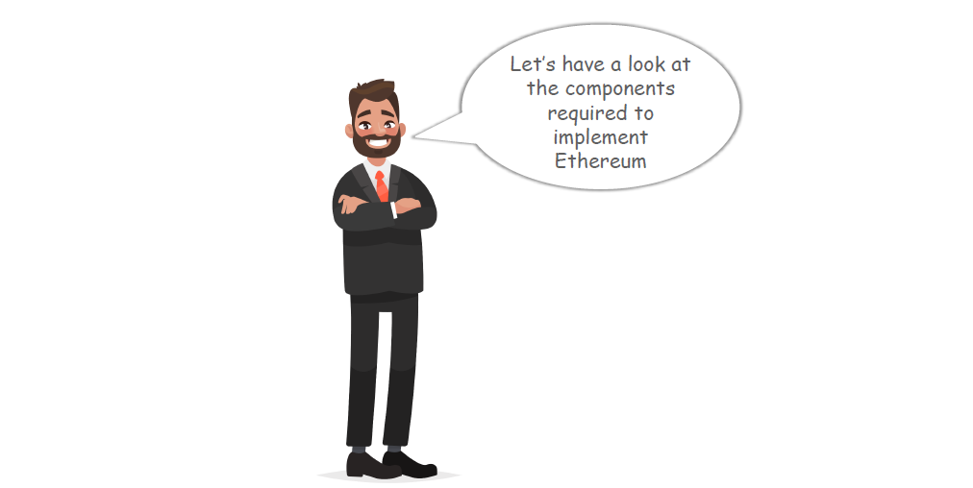

Slide 12

Four Main Components of a Blockchain Ecosystem
To implement blockchain we need following four components:
Blockchain Ecosystem
Node Application
Shared Ledger
Consensus Algorithm
Virtual Machine
However, according to the implementation, one or two of these components might differ, for example bitcoin does not uses any virtual machine but Ethereum has a virtual machine

Slide 13



Components of Blockchain Ecosystem Explained
NODE APPLICATION
Each Node have to install and run a computer application definitive to the ecosystem they wish to participate in.
Example- In bitcoin ecosystem, each
computer must be running the bitcoin wallet
SHARED LEDGER
A data structure(Ledger) is managed inside the node application. Contents for the ecosystem can be viewed, once the node application is in running state
CONSENSUS ALGORITHM
Implemented as part of the node application. Provides the rule for how the ecosystem will arrive at a single view of the ledger
VIRTUAL MACHINE
An abstraction of a machine operated with instructions and Implemented as part of the node application that every participant in the ecosystem runs

Slide 14
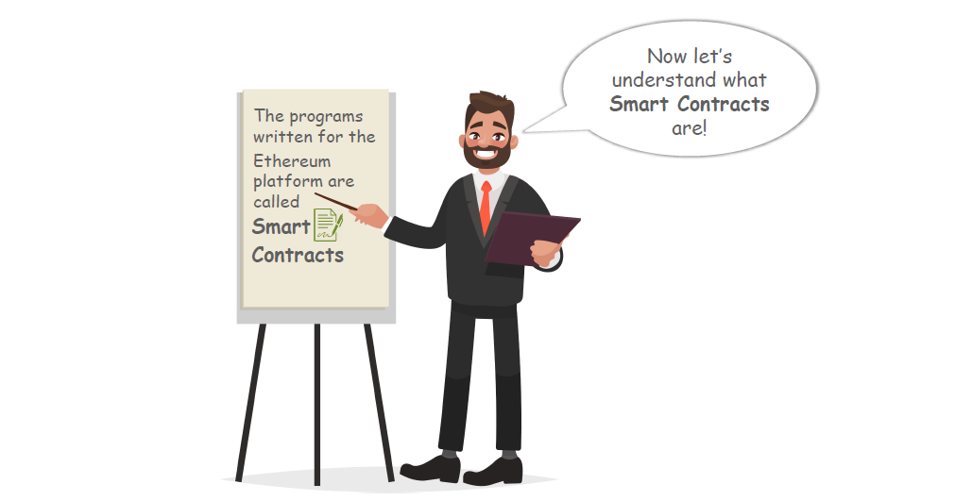

Slide 15
Introducing Smart Contracts

Slide 16

Introducing Smart Contracts
The basic building blocks of programs written for the ethereum platform are called “smart contracts”. Let’s
understand what are smart contracts

Slide 17
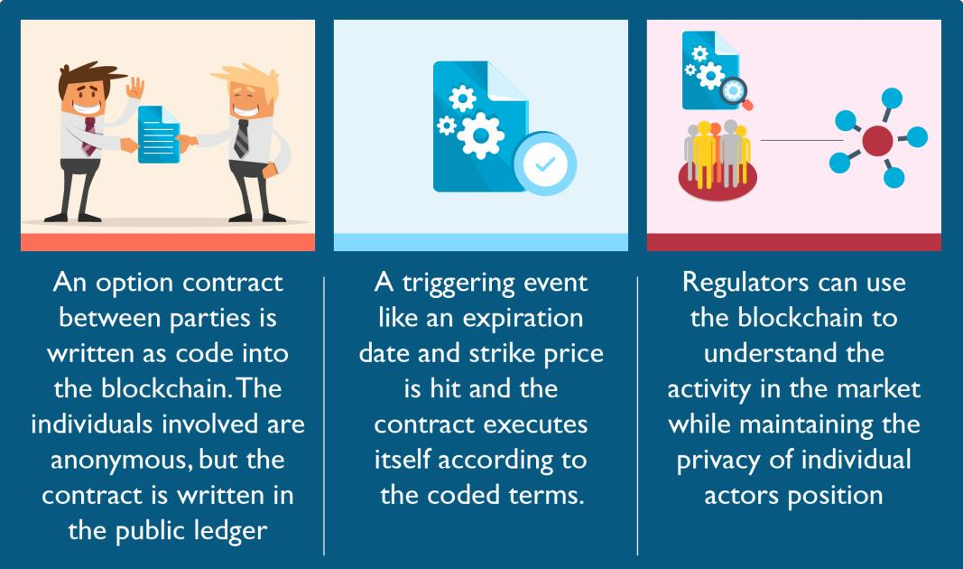
Smart Contracts
A smart contract is a computerized transaction protocol that executes the terms of a contract
When running on the blockchain a smart contract becomes like a self-operating computer program that automatically executes when specific conditions are met

Slide 18
Characteristics of Smart Contracts
Tracking performance in real time and can bring tremendous cost savings
Compliance and controlling happen on the fly.
Smart Contracts are
Self-verifying
Self-executing
Tamper resistant
Smart Contracts can
Turn legal obligations into automated processes.
Guarantee a greater degree of security.
Reduce reliance on trusted intermediaries.
Lower transaction costs.

Slide 19
Example Smart Contracts

Slide 20
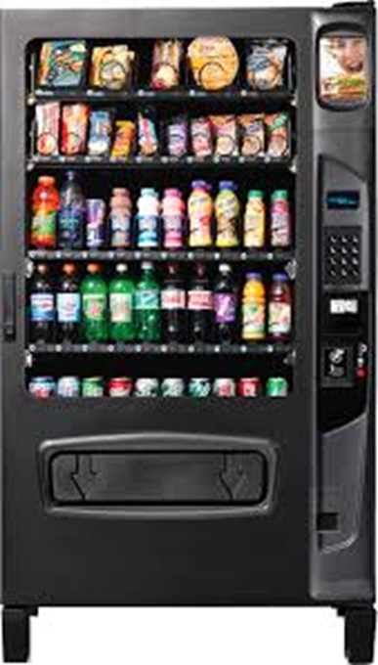
Smart Contract Example: Vending Machine
Primitive form of a smart contract is a vending machine
Primitive form of a smart contract is a vending machine
select a product by pressing a number related to that product, insert the coins, the machine acts as a smart contract checking whether you inserted enough money
If yes, the machine is programmed to eject the product, and if you inserted too much money, it will also eject the change.
If you didn’t insert enough money, or if the machine ran out of the money, you will get your change back.
Automatic vending machines not only slashed transaction costs by making human vendors obsolete, but they also expanded service, offering 24/7 availability instead of limited opening hours of a kiosk

Slide 21
Smart Contract – How it works?
Smart Contract - Machines take decisions on their own
Computer code running on top of Blockchain containing predefined set of rules
If and when the pre-defined rules are met, the agreement is automatically enforced
Perfect decentralized automated application for
Verification
Enforcing the negotiation
Performance of an agreement (or) transaction
The term smart contract is a bit unfortunate since a smart contract is neither smart nor are they to be confused with a legal contract.
A smart contract can only be as smart as the people coding taking into account all available information at the time of coding.
While smart contracts have the potential to become legal contracts if certain conditions are met, they should not be confused with legal contracts accepted by courts and or law enforcement. However, we will probably see a fusion of legal contracts and smart contracts emerge over the next few years as the technology becomes more mature and widespread and legal standards are adopted.

Slide 22
Smart Contract – How it works?
Slashing Transactions Costs of Coordination & Enforcement
Would you enter into a contract with someone whom you’ve never met?
Would you agree to lend money to some farmer in Ethiopia?
Would you become an investor in a minority-run newspaper in a war zone?
Would you go to the hassle of writing up a legal contract for a $5 purchase over internet?
No, The transaction costs for these examples exceed the value transferred.
Smart contracts radically reduce transaction costs.
Auto enforceable code – whether on the protocol level or on the application level – standardizes transaction rules, thus reducing the transaction costs of:
Reaching an agreement,
Formalization, and
Enforcement.
Smart contracts radically reduce transaction costs.

Slide 23
Ethereum Wallet

Slide 24
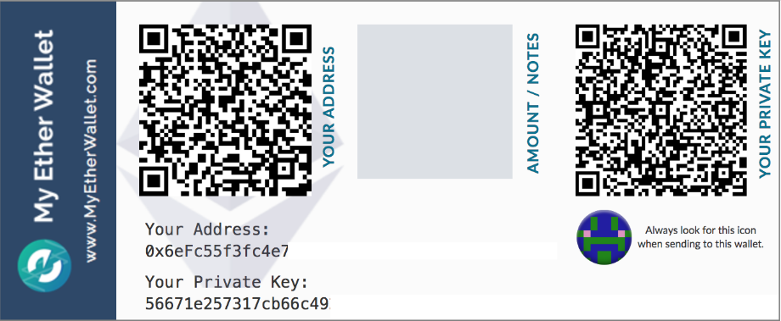
Ethereum Wallet
Ethereum wallet is a secure digital wallet used to store, send, and receive ether
Ether itself is not actually “stored” in a wallet
A private key (secure digital code known only to you and your wallet) is stored that shows ownership of a public key
Wallet stores your private and public keys, allows you to send and receive coins, and also acts as a personal ledger of transactions

Slide 25
Ethereum Wallet..
Desktop Wallet: The most common type of wallet. Typically an app that connects directly to a coin’s client.
Mobile Wallet: A wallet that is run from a smartphone app.
Online Wallet: An online wallet is a web-based wallet. You don’t download an app, but rather data is hosted on a real or virtual server. Some online wallets are hybrid wallets allowing encryption of private data before being sent to the online server. Some wallets let you control your private keys, some are custodial (you don’t control your keys directly).
Hardware Wallet: Dedicated hardware that is specifically built to hold cryptocurrency and keep it secure. This includes USB devices. These devices can go online to make transactions and get data and then can be taken offline for transportation and security.
Paper Wallet: You can print out a QR code for both a public and private key. This allows you to both send and receive digital currency using a paper wallet. With this option, you can completely avoid storing digital data about your currency by using a paper wallet.

Slide 26
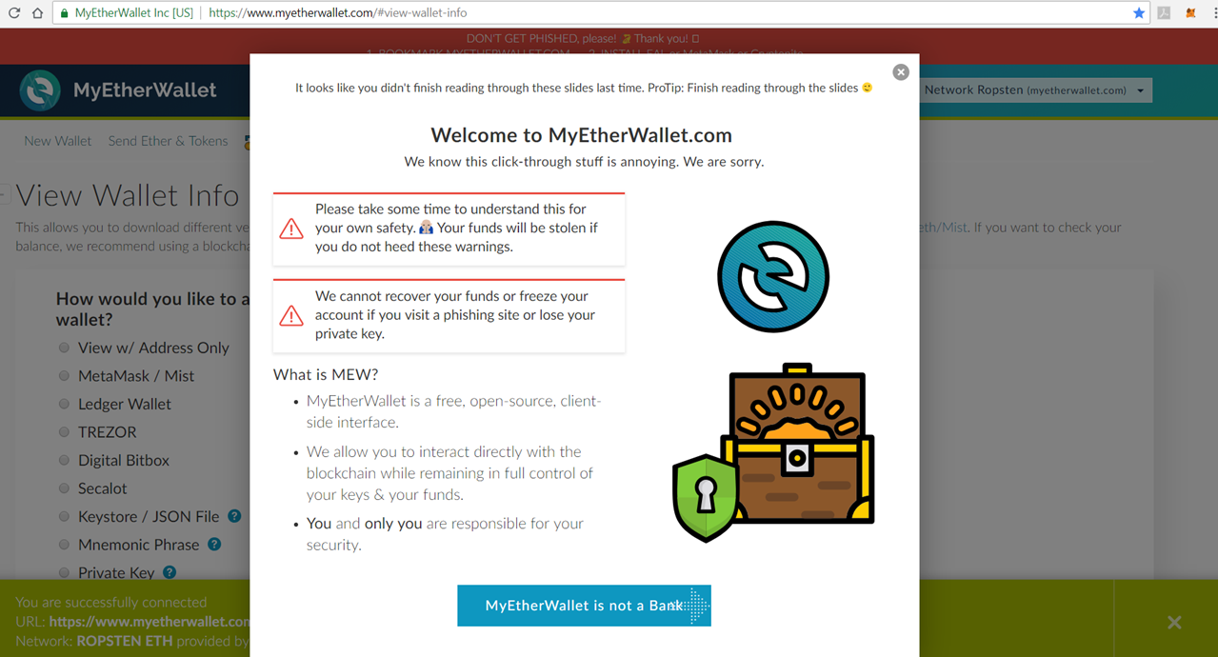
Ethereum Wallet – myetherwallet.com

Slide 27
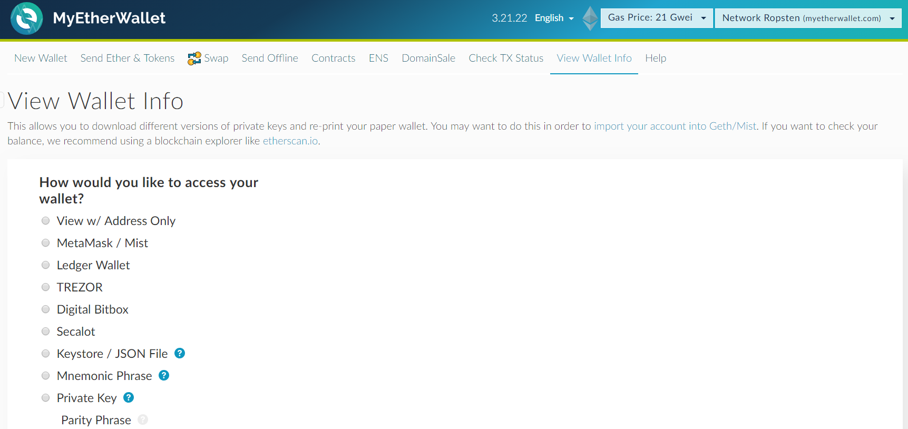
Ethereum Wallet – myetherwallet.com

Slide 28
Compare Traditional Vs Smart Contracts

Slide 29
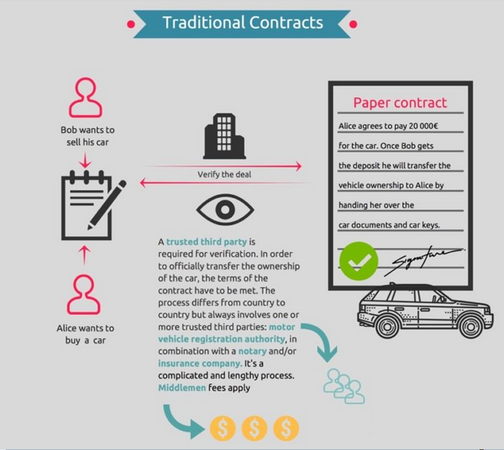
Traditional Contracts

Slide 30
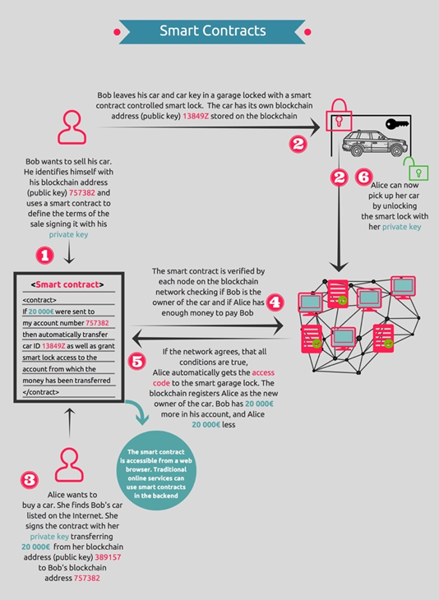
Smart Contracts
If the network agrees that both conditions are true, Alice automatically gets the access code to the smart lock for the garage. The blockchain registers Alice as the new owner of the car. Bob has € 20,000 more on his account, and Alice € 20,000 less. No middlemen required.
On the Blockchain, who owns what is transparent and at the same time anonymous or pseudonymous. This means that every computer running the blockchain protocol could check whether a certain person is the rightful owner of the car or not.
Stealing cars won’t be as easy as today, especially once we have smart keys granting access control verified on the blockchain, to unlock our future vehicles. As the owner of the car, you could authorize other people to drive it (stating the public key of the respective individual). In such cases opening the car would only be possible with a smart key on the Blockchain.

Slide 31
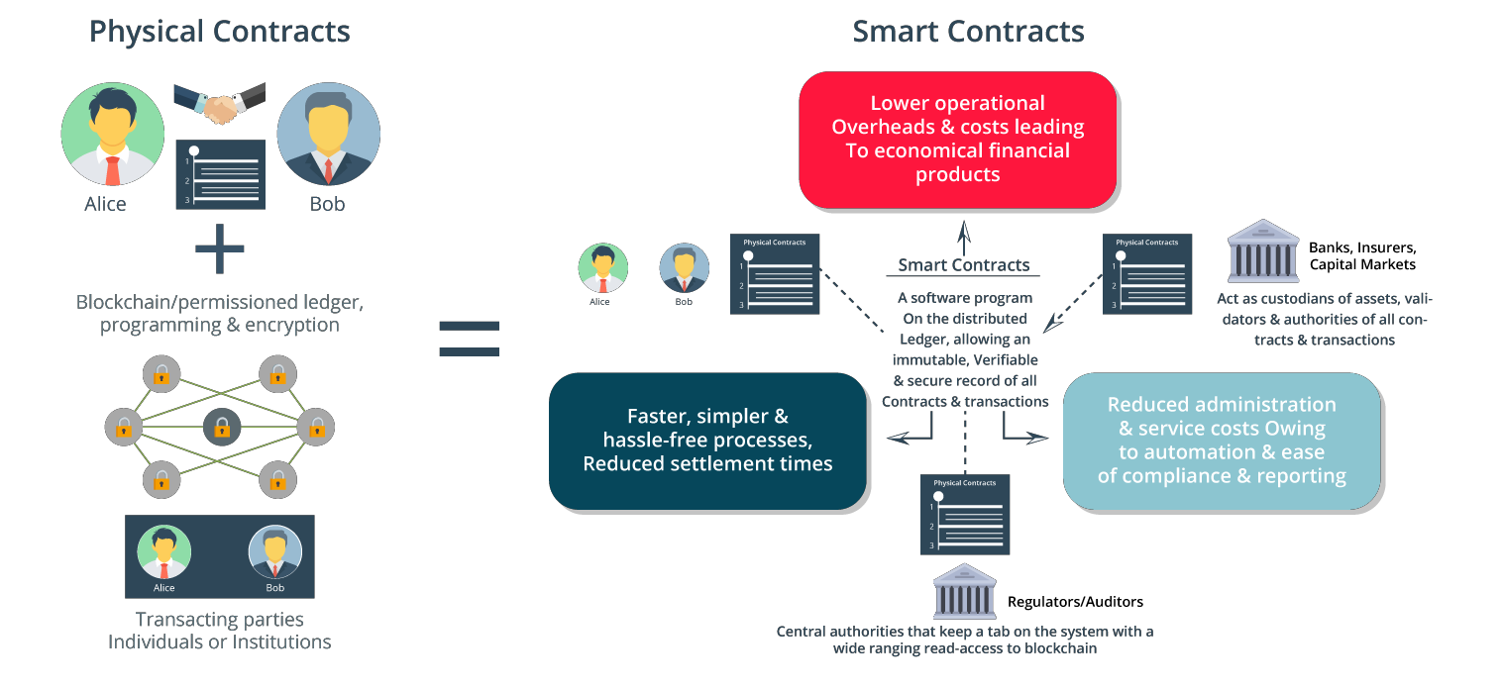
How Smart Contracts Work in a Permission Blockchain

Slide 32
Cryptocurrency used in Ethereum
Ethereum is incomplete without cryptocurrency.
Let’s have a look at the cryptocurrency used in Ethereum

Slide 33
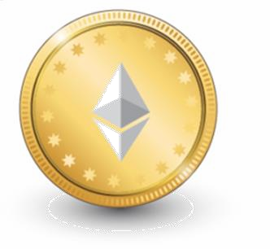
Ether
The value token of the Ethereum blockchain is called Ether
It is listed under the code ETH and traded on cryptocurrency exchanges
It is also used to pay for transaction fees and computational services on the Ethereum network
Every time a contract is executed, Ethereum consumes tokens which is termed as ‘gas’ to run the
computations

Slide 34
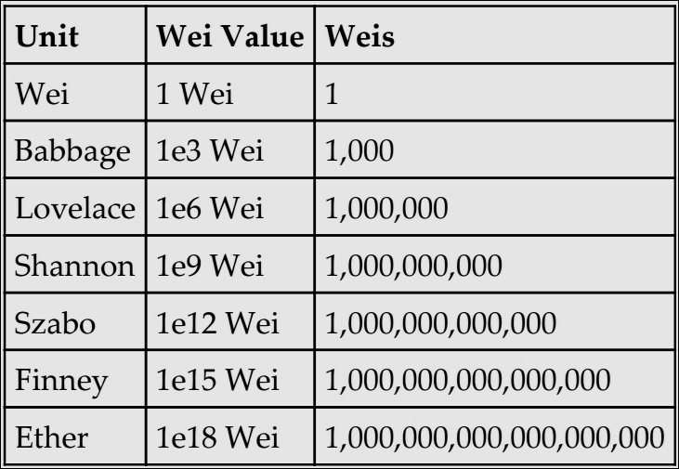
Denomination Table of Ether

Slide 35
Ether is Used to Purchase Gas, a Crypto Fuel
Let’s understand what gas is in the Ethereum system and why is it necessary

Slide 36
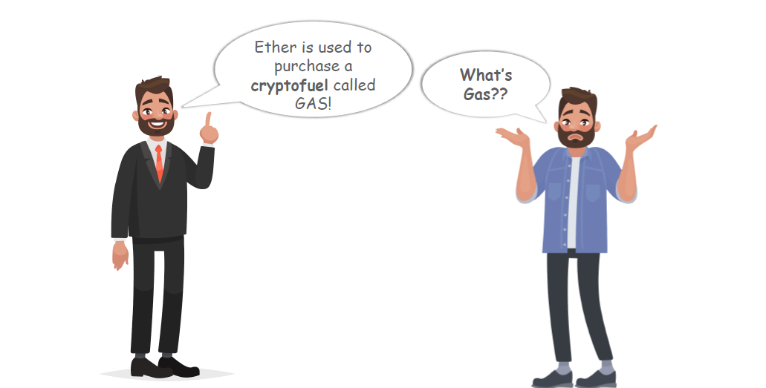
Ether is Used to Purchase Gas, a Crypto Fuel

Slide 37
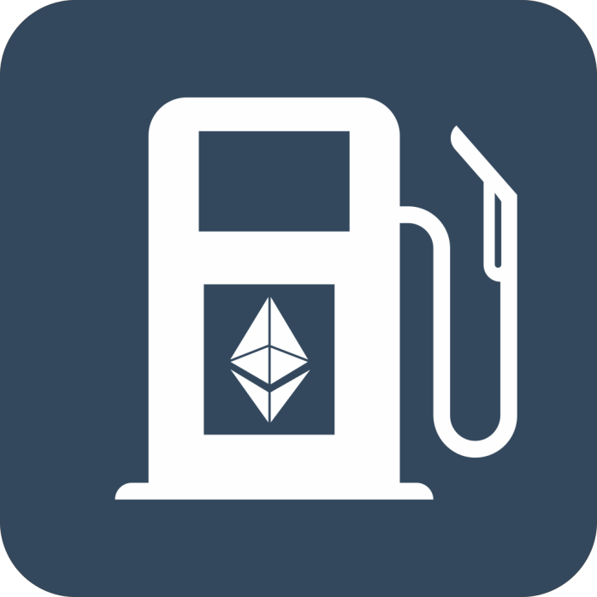
Gas in Ethereum
Gas is required to be paid for every operation performed on the ethereum blockchain
A transaction fee is charged as some amount of Ether and is
taken from the account balance of the transaction originator
A fee is paid for transactions to be included by miners
The more the fee, the higher are the chances that the transactions will be picked up by the miners for inclusion in the block
Providing too little gas will result in failed transaction
Ether buys Gas to fuel up the EVM

Slide 38
Estimating Transaction Cost
Transaction cost can be estimated using the following formula:
Total cost = gasUsed * gasPrice
gasUsed is the total gas that is supposed to be used by the transaction during the execution
gasPrice is specified by the transaction originator as an incentive to the miners
Note: Current Gas Price can be checked online(Ethgasstation or Etherscan), and the Gas Limit for things other than simple transfers can only be known by looking at the smart contract code or by looking at what the organization behind the ICO/smart contract says is appropriate for their smart contract

Slide 39
Transactions in Ethereum
The most notable difference between the Bitcoin and Ethereum blockchain is that ethereum blocks contain both a transaction list
and the most recent “state” of the ledger of these transactions
Let’s have a look at the transactions and Accounts in Ethereum Blockchain

Slide 40
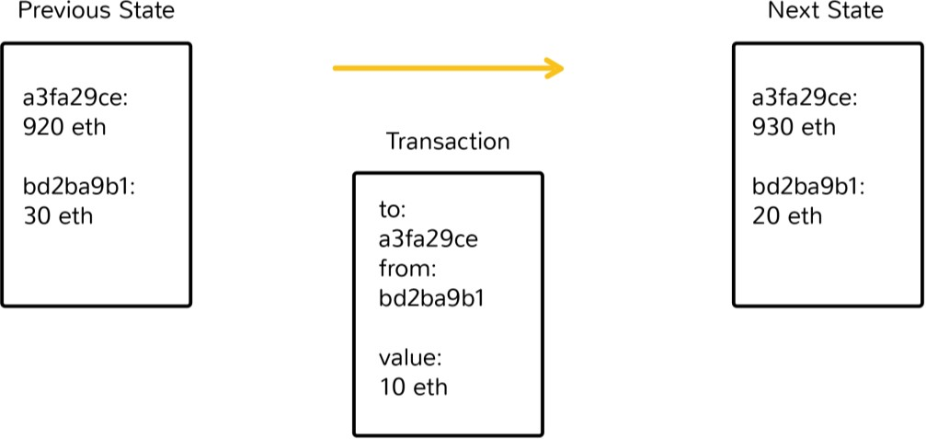
Transactions
The term “transaction” is used in Ethereum to refer to the signed data package that contains a message to be
sent from an externally owned account to another account on the blockchain
Ethereum blocks contain both a transaction list and the most recent “state” of the ledger of these transactions
Accounts are one of the main building blocks of the Ethereum blockchain

Slide 41
Types of Accounts

Slide 42
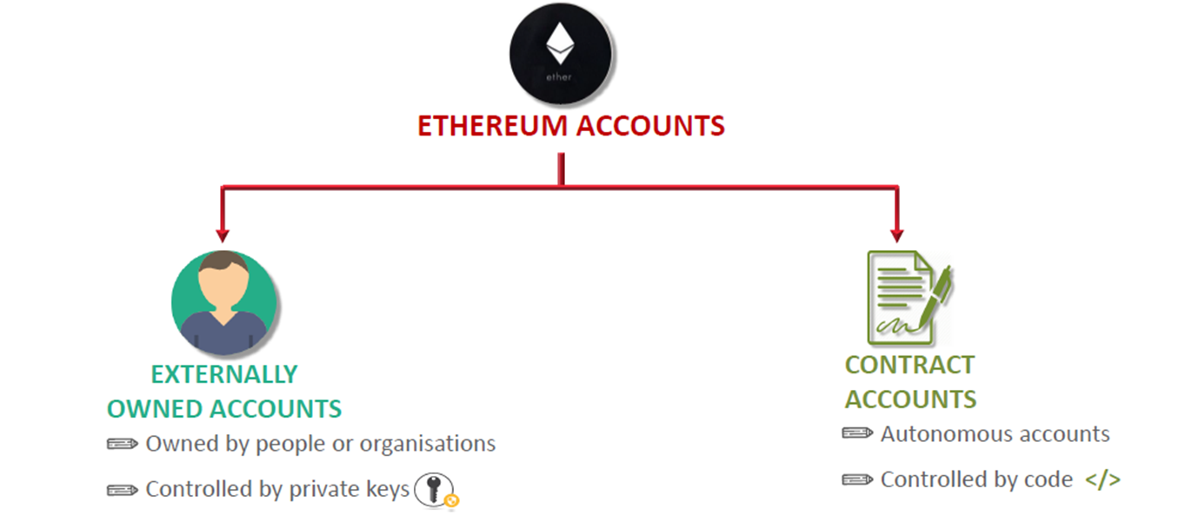
Types of Accounts

Slide 43
Types of Accounts
Ethereum maintains two types of accounts:
Externally owned accounts (EOAs): Defined as the basic form of account, EOAs interact with and generate updates on the Ethereum blockchain
Contracts: Programmatically execute when they receive instructions in the form of a transaction from an EOA. Contracts can push or pull funds, and request these actions from other contracts, calling on the code to perform dynamic actions
If the transaction recipient is a contract, then that contract’s code will execute, changing both the state of that
contract and potentially triggering other contracts to execute code as well
The state of all accounts is the state of the Ethereum network, which is updated with every block and which the network really needs to reach a consensus about

Slide 44
How Validation happens in Ethereum Blockchain
Let’s see how transactions happens and a block is created in Ethereum Blockchain

Slide 45
Validators (or Miners)
Just like in Bitcoin, transactions are validated by the Miners
Anyone can take on the role of a miner and validate block of transactions
It takes around 12-15 seconds approximately for a miner to validate or mine a block
At a theoretical level, a miner performs the following functions:
Listens for the transactions broadcasted on the Ethereum network and determines the transactions to be
processed
Determines stale blocks called Uncles or Omners and includes them in the block
Updates the account balance with the reward earned from successfully mining the block
Finally, a valid state is computed and block is finalized, which defines the result of all state transitions

Slide 46

Mining Reward
In order to incentivise miners for supporting the Ethereum network, a block reward is granted to the lucky miner who generates the “correct” block
Currently, the block reward is set at 5 Ether
This will contribute to the inflation in the number of Ether available and hence, the value of each Ether

Slide 47
Consensus Mechanism in Ethereum
For any distributed computing system to properly function, there needs to be a mechanism by which the entire network can come to an agreement on its state, or how its token supply is divided among registered addresses on the network
Let’s have a look at the consensus mechanism used in Ethereum

Slide 48
Consensus Algorithm
At the time of writing, Ethereum uses a similar Proof-of-work protocol known as Ethash
Similar to bitcoin, the core idea behind mining is to find a nonce that once hashed the result in a
predetermined difficulty level
It uses different cryptographic primitive for its hashing function, known as SHA-3, rather than SHA-256
Ethash is designed to make Ethereum both resistant to the high-powered mining chips that currently dominate the bitcoin industry, and more accessible to “light” client implementations that allow users to use Ethereum without needing to first download the Ethereum blockchain to their device, however light clients downloads headers of the blocks for reference

Slide 49
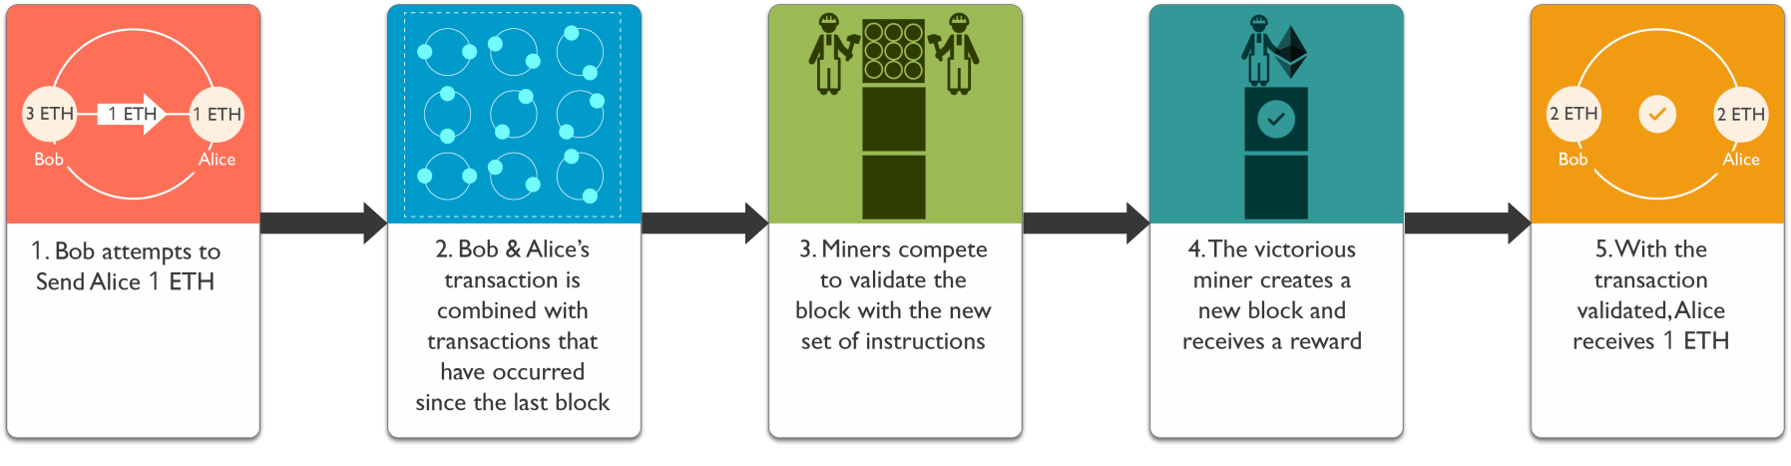

Mining at a Glance

Slide 50
Ethereum does far more than Processing Transactions
The Ethereum Blockchain is intended to do far more than process shared transactions. It is designed to execute complex code, where the functionality is only restricted by the imagination of its developers and accessible resources
The complex codes are executed in Ethereum Virtual Machine

Slide 51
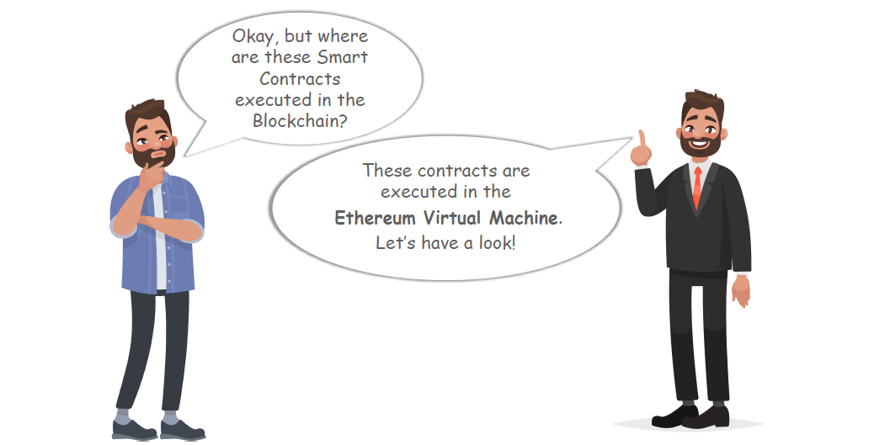

Slide 52
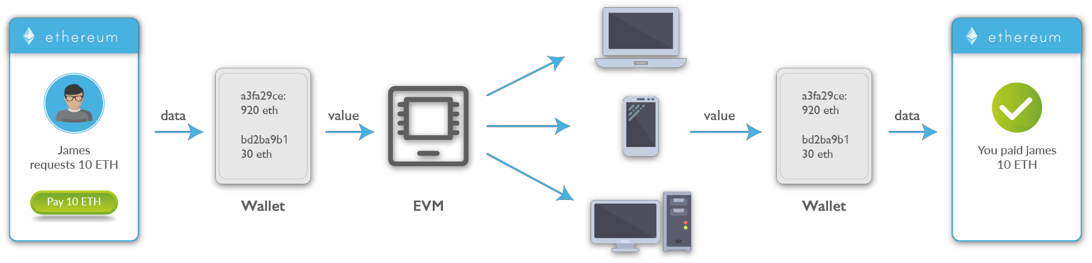
Ethereum Virtual Machine
The Ethereum virtual machine is the engine in which transaction code gets executed
E.V.M. enables the development of potentially thousands of different applications all on one platform
Contracts written in a smart contract-specific programming languages are compiled into 'bytecode', which a
EVM can read and execute
All the nodes execute this contract using their EVMs

Slide 53
Ethereum – Road Ahead
Metropolis
Metropolis is next major Ethereum upgrade. Metropolis was introduced on github for testing and its just a matter of time before it goes live. Not only introducing further protocol upgrades and opening the door for casper, but also new interfaces for non technical users. This will help gain further adaptation and also it will help developers create easy to use apps
Serenity
Serenity is the last phase in Ethereum network. Release was planned for the start of 2018, but we might have some delays, as usually. Serenity goal is to switch from proof-of work to proof-of-stake, by using a method called Casper

Slide 54
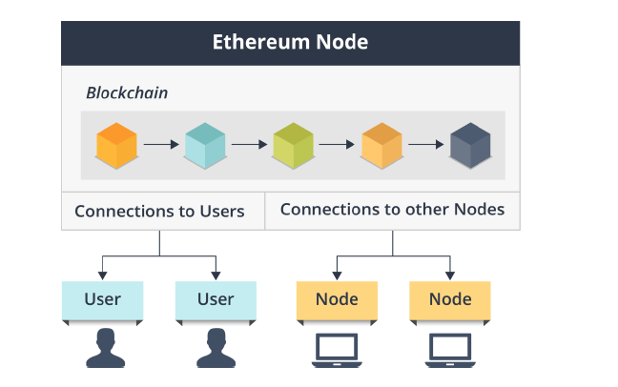
Ethereum Node Interactions

Slide 55
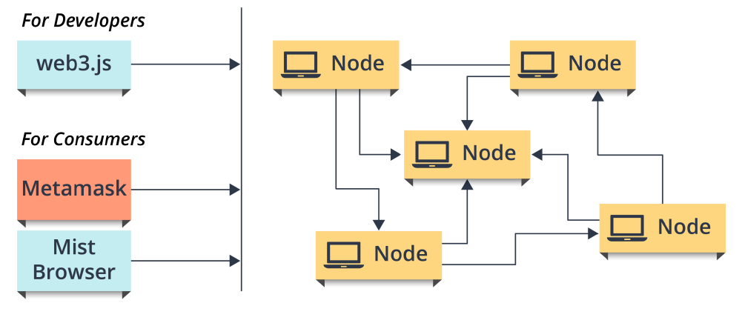
Ethereum Node Interactions

Slide 56
Development Technologies that seek to help Network
In addition to the main Ethereum blockchain protocol, there are also supporting technologies in development that seek to help the network, and components built on the network, run more efficiently

Slide 57
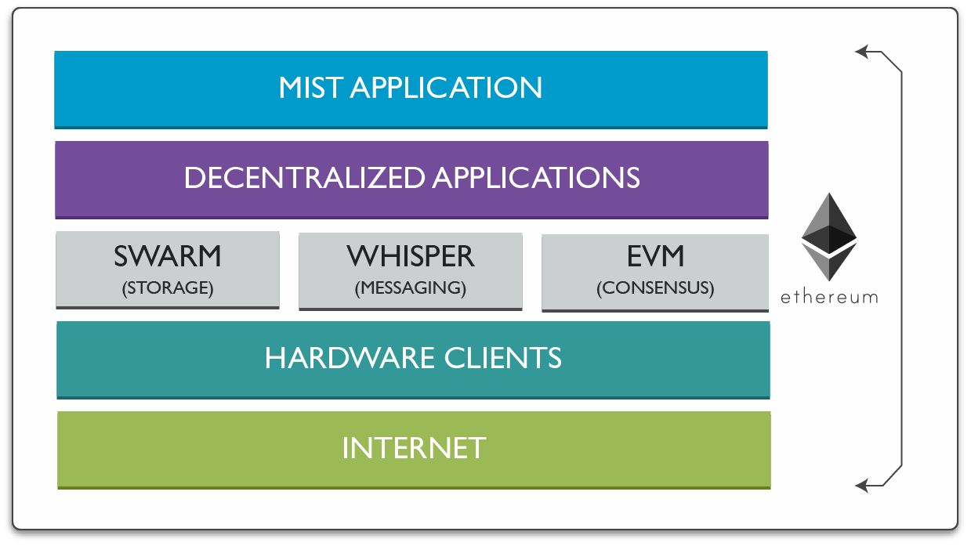
Supporting Technologies
Web 3.0 Technology Stack

Slide 58
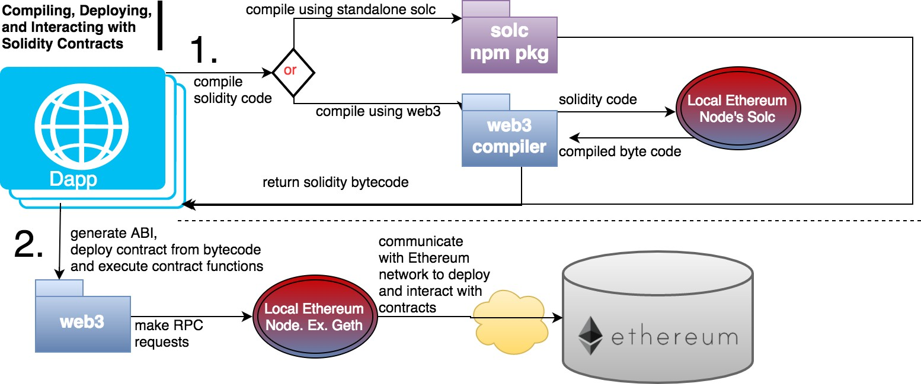
Web3.js
The key connection between the Ethereum network and your DApp
Web3 allows you to compile, deploy, and interact with your smart contracts

Slide 59
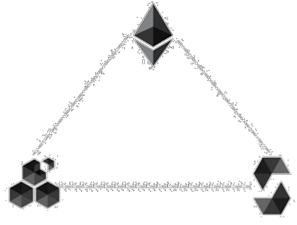
Messaging and File Sharing
The Ethereum project also introduced two additional protocols to provide peer to peer support for exchanging message as well exchanging static files
The peer to peer protocol used for exchanging message is named Whisper
The peer to peer protocol used for exchanging static files is named Swarm
Ethereum
Swarm
Whisper

Slide 60

Decentralized Messaging
Whisper provides a peer to peer protocol for exchanging short timed messages privately
Whisper relies on a subject key (Topic) approach to deliver
messages where messages are published using hashed topic
Indirectly supports broadcast, multicast and unicast
Whisper is a high latency and low bandwidth messaging protocol
Provides the ability to use masks/filters narrow down topics of
interest without giving away what topic is being sought
Whisper

Slide 61

File Transfer
Leverages the underlying ethereum infrastructure through the use of a contracts and ethers to encourage cooperation among nodes
Files are split into chunks which are stored in nodes in the network
An accounting protocol is used by peers to keep track of chunks delivered and received and resulting micro payments owed
Swarm

Slide 62
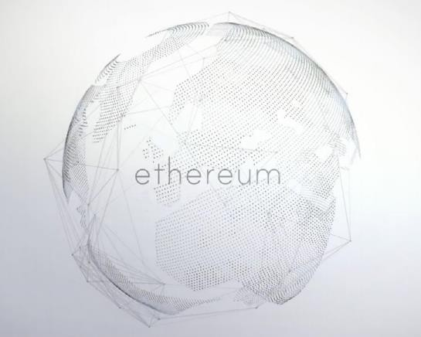
Mist Application
Styled as a decentralized application discovery tool, Mist is meant to serve as a wallet for smart contracts that features a graphical user interface
A desktop application is used to communicate with your node
Allows users to dynamically set transaction fees and manage custom tokens

Slide 63
Mist Browser v/s Ethereum Wallet
Mist DApp Browser
Mist is the browser for decentralized web apps
Mist is still in heavy development (it's not recommended to visit untrusted DApps until the full security audit
is done).. The current release allows you to open any Ethereum DApp with the Mist Browser
Ethereum Wallet DApp
The Ethereum Wallet, also known as the Meteor DApp Wallet
These releases are therefore called Ethereum Wallet as it only offers a bundle of the Mist browser with a single DApp: the wallet
The future, with Metropolis release, will provide a full Mist Browser able to open any DApp available out
there

Slide 64
Components for Development

Slide 65
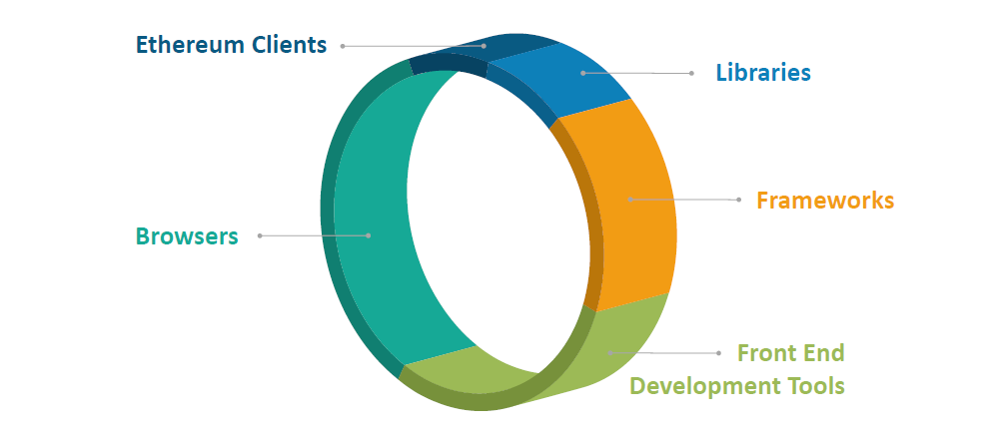
Components in Developing Ethereum DApps

Slide 66
Ethereum Clients to Interact with Contracts
Developers write up the contracts, which are then converted into the EVM bytecode via a EVM complier and uploaded onto the blockchain using an Ethereum client
There are various Clients supporting the Ethereum network. Let’s see what Clients are and what purpose they serve

Slide 67
Ethereum Clients
Since the start of the Ethereum project, there have been multiple client implementations across a range of different operating systems and programming languages. This client diversity is essential for the long-term health of the Ethereum network.
Ethereum clients are softwares that allow users to:
Validate transactions/blocks
Create/manage Ethereum accounts
Send/receive transactions from/to your Ethereum accounts
Deploy contracts onto the blockchain
“Mine” Ethereum blocks

Slide 68
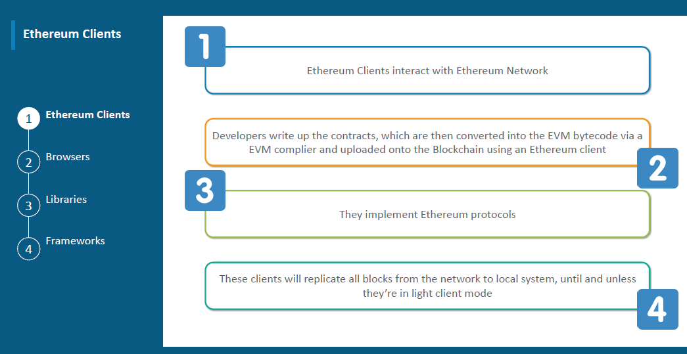
Ethereum Clients

Slide 69
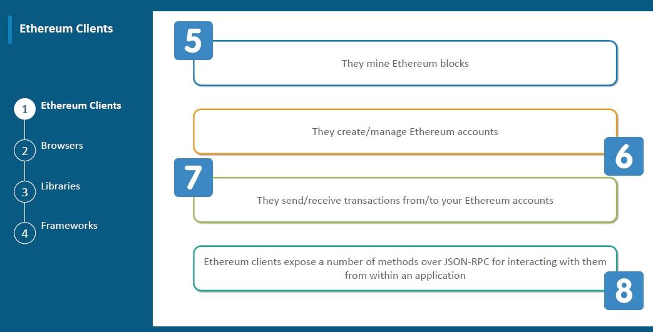
Ethereum Clients..

Slide 70
List of Ethereum Clients
Client | Language | Developers
Go-Ethereum (Geth) | Go | Ethereum Foundation
Parity | Rust | Ethcore
Cpp-Ethereum | C++ | Ethereum Foundation
Pyethapp | Python | Ethereum Foundation
Ethereumjs-lib | Javascript | Ethereum Foundation
Ethereum(J) | Java | <ether.camp>
Ruby- ethereum | Ruby | Jan Xie
EthereumH | Haskell | Blockapps

Slide 71
Go-Ethereum & Parity Clients
The most popular implementations now are go- ethereum and Parity, which will be discussed in the further slides

Slide 72
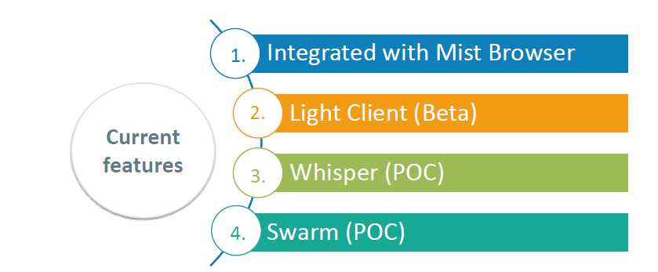
Go-Ethereum
The go-ethereum client is commonly referred to as geth, which supports the running a full Ethereum node implemented in the Go language
Current features:
Integrated with mist browser
Light client (Beta)
Swarm (POC)
Whisper (POC)

Slide 73
Download Go-Ethereum

Slide 74
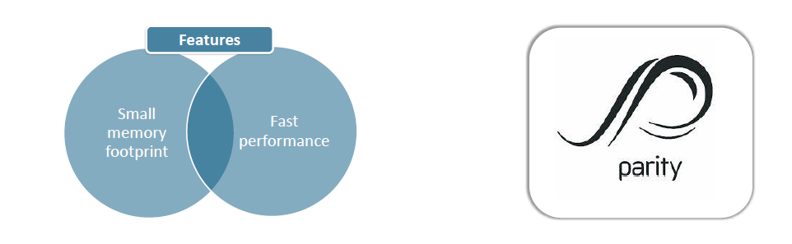

Parity
Parity claims to be the world’s fastest and lightest Ethereum client
It is written in the Rust language, which offers improved reliability, performance, and code clarity
Parity is being developed by Ethcore, which was founded by several members of the Ethereum Foundation
Current features:
Small memory footprint
Fast performance

Slide 75
Download Parity

Slide 76
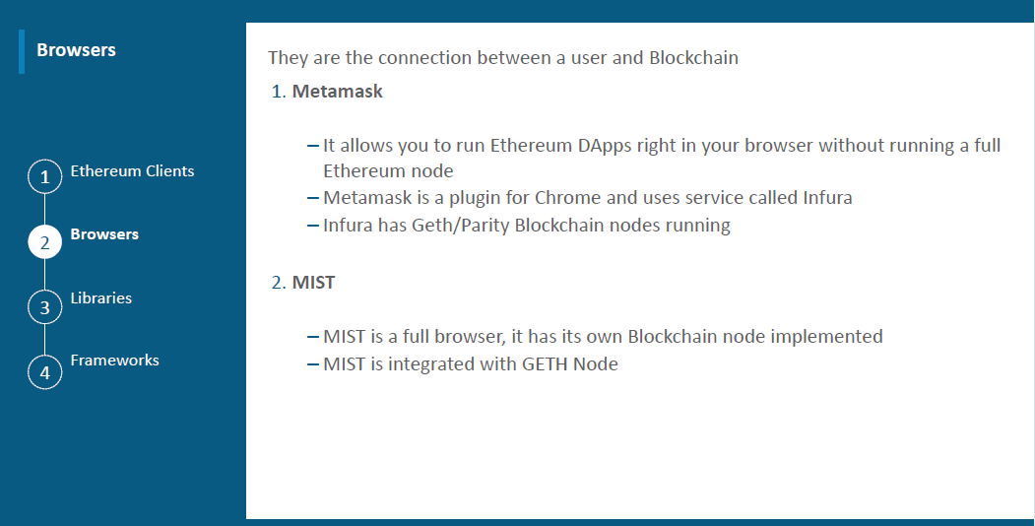
Ethereum Browsers

Slide 77
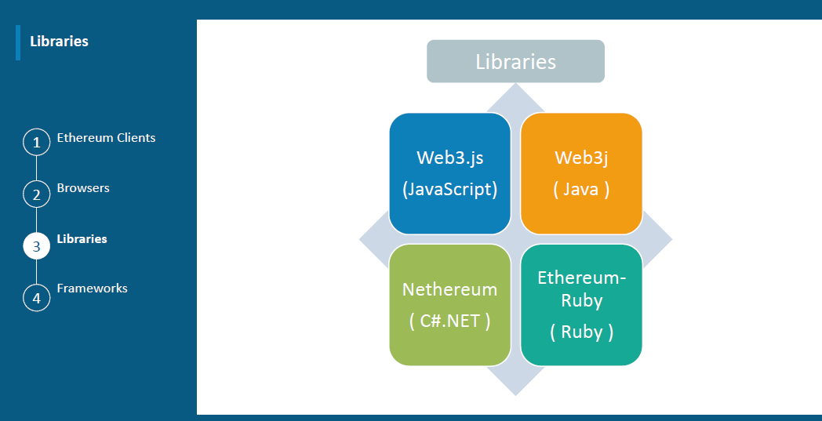
Ethereum Libraries

Slide 78
Web3.js
The key connection between the Ethereum network and your DApp
Web3 allows you to compile, deploy, and interact with your smart contracts

Slide 79
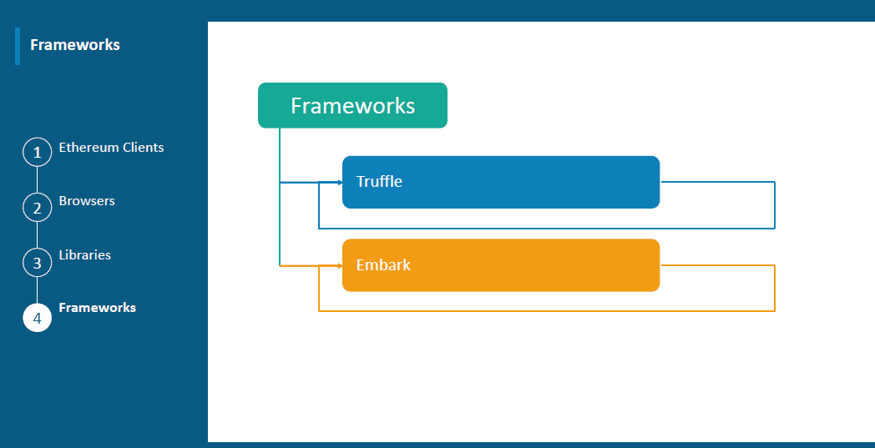
Ethereum Frameworks

Slide 80
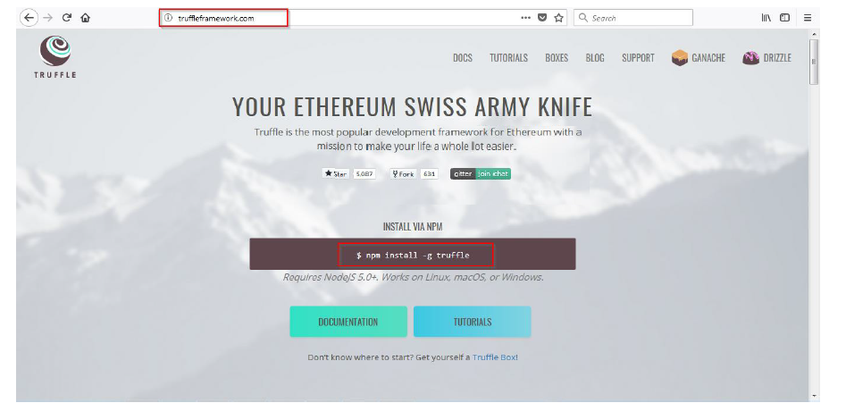
Download Truffle

Slide 81
Ethereum Editor & Tools

Slide 82
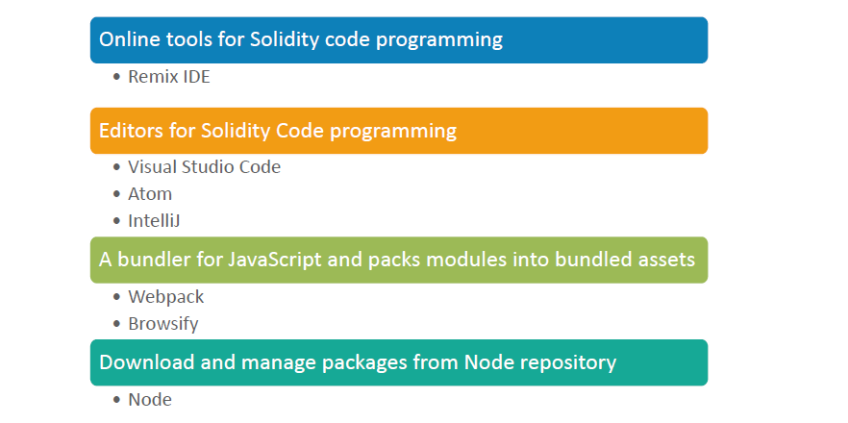
Ethereum Editor and Tools

Slide 83
Ethereum Front End Development

Slide 84
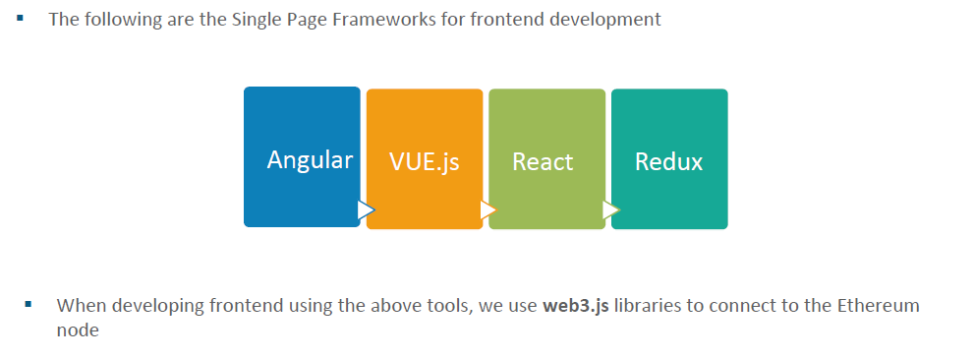
Ethereum Front-End Development

Slide 85
Ethereum Test Networks

Slide 86
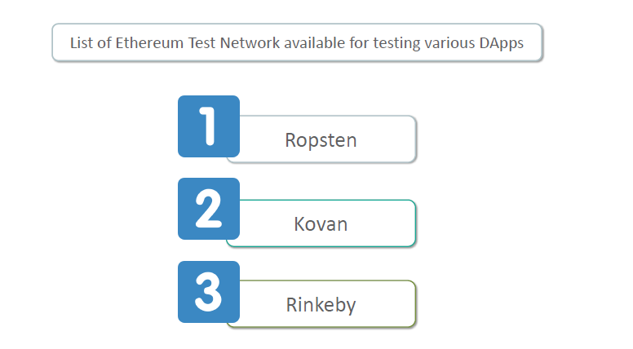
Ethereum Test Networks

Slide 87
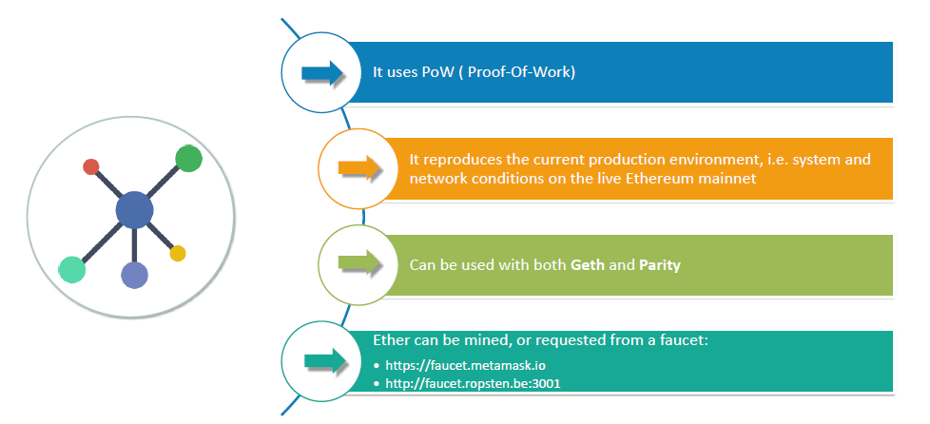
Ethereum Test Networks: Ropsten

Slide 88
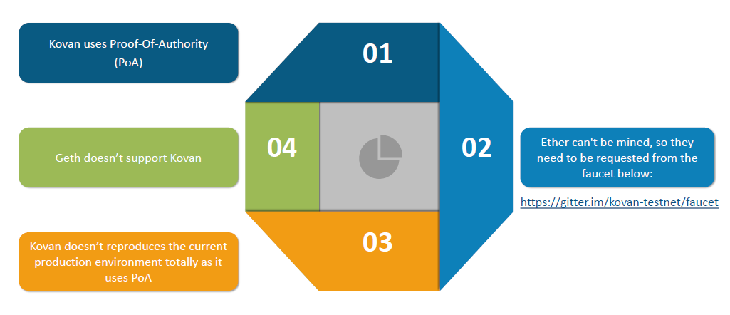
Ethereum Test Networks: Kovan

Slide 89
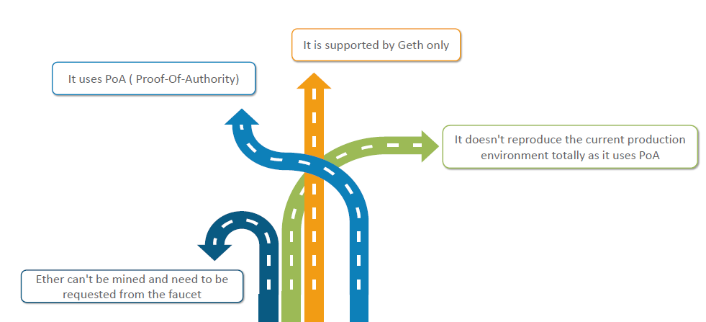
Ethereum Test Networks: Rinke by

Slide 90
Ethereum Request for Comments
ERC Tokens

Slide 91
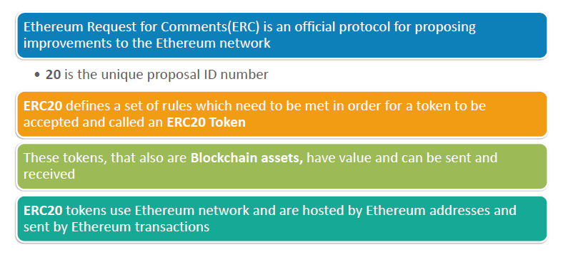
Ethereum Request for Comments (ERC’s)

Slide 92
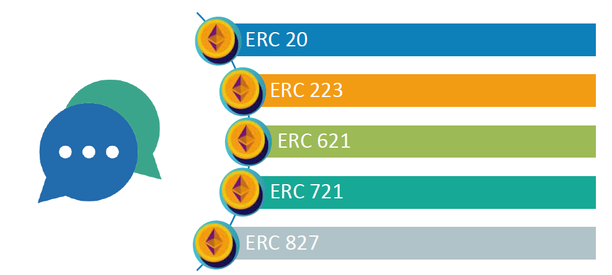
Available ERC Token Standards

Slide 93
Platform for Smart Contract

Slide 94
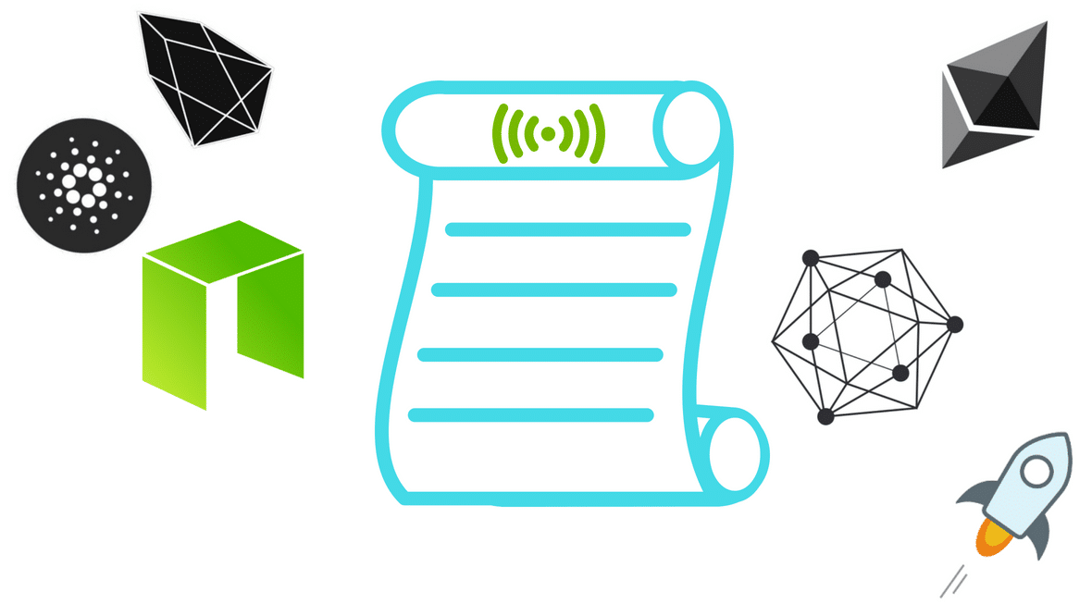
Platform for Smart Contract
EOS
Ave
Neo
EPH
QTM
Stellar

Slide 95
Platform Functions in Ethereum

Slide 96
Platform Functions in Ethereum
While the architecture of the network is certainly impressive, it’s what’s built on these intricate components that truly illustrates Ethereum’s potential
Let’s have a look at the various platform functions in Ethereum

Slide 97
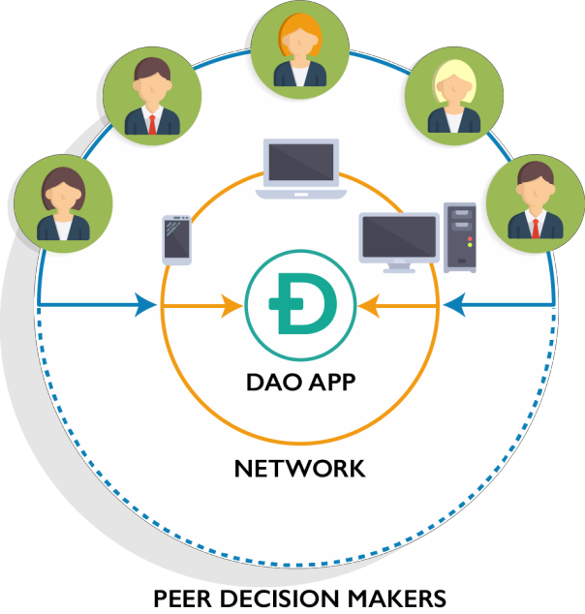
DAO (Decentralized Autonomous Organization)
DAOs are organizations that exist entirely on a blockchain and are governed by its protocols
A unison of many long-term smart contract between many people
DAOs are designed to hold onto assets and use a kind of voting system to manage their distribution
Two or more entities in DAO can interact with each other in a fully
decentralized and automated fashion
DAOs comprise a global network of nodes and members that all work together
In the DAO, Each action or vote is represented by some form of transaction in
the Blockchain

Slide 98
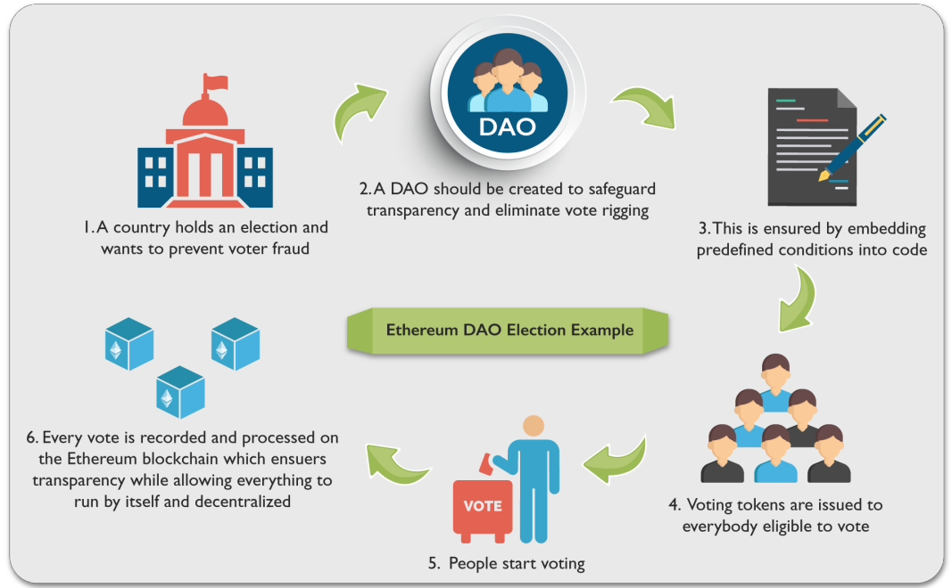
Here’s how DAO work
A group of people writes a smart contract to govern the organization
People add funds to the DAO and are given tokens that represent ownership
The DAO begins to operate by having members to propose how to spend the money
The members vote on these proposals
When the predetermined time has passed and the predetermined number of votes has accrued, the proposals passes or fails
Individuals act as contractors to service
the DAO
ensures
Example of a DAO

Slide 99
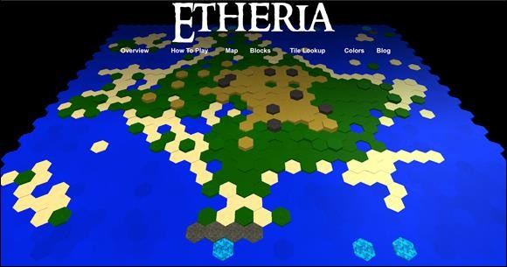
DApps (Decentralized Applications)
Decentralized applications or DApps are computer applications that operate over a blockchain enabling direct interaction between end users and providers
Dapps can be comprised of single DAO or even a series of DAOs that work together to create an application
A decentralized application has an unbounded
number of participants on all sides of the market
ETHERIA (www.etheria.world), a Minecraft-like game

Slide 100
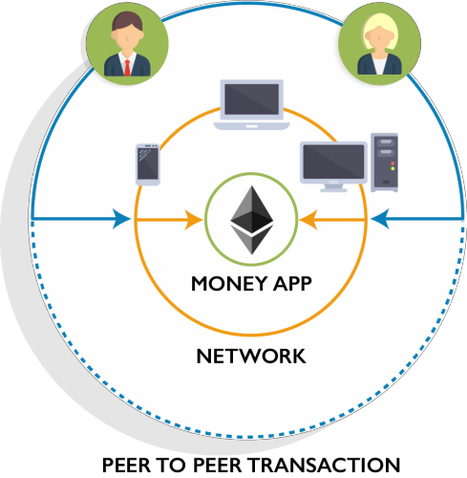
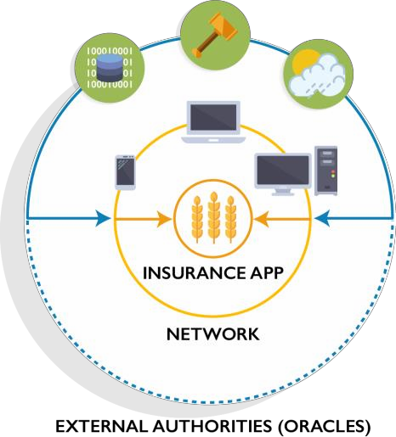
Types of DApps
1st Type: A user may need to exchange ether as a way to settle a contract with another user, using the network's distributed computer nodes as a way to facilitate the distribution of this data
2nd Type: The app mixes money with information from outside the blockchain. For example, a crop insurance application that's dependent on an outside weather feed. (Say a farmer buys a derivative that automatically pays out if there's a drought that impacts his work.)
3rd Type: DAO
The goal is form a leaderless company, program rules at the beginning about how members can vote and how to release company funds and then... let it go

Slide 101
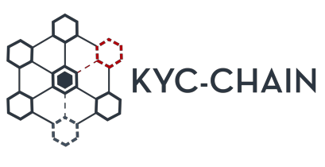



Future of DApps
As Ethereum and other projects have made writing DApp protocols quicker and more accessible, a number of
possibly disruptive DApps have appeared
KYC-Chain allows users to maintain private “identity wallet” which can be used to authenticate
their identification in finance, legal, or commerce settings
WeiFund uses smart contracts to enhance crowdfunding services including GoFundMe and
Kickstarter
Storj provides censorship-free, secure, and zero-downtime distributed cloud storage by sharing data and storing it among a decentralized network of computers
4G Capital — provides micro loans for small businesses in Africa by utilizing smart contracts.
Note: A curated collection of various DApps can be seen at this address: https://www.stateofthedapps.com/

Slide 102
Programming In Solidity

Slide 103
Introducing Solidity
Ethereum would be incomplete without a native programming language – and that language is Solidity.
Let’s learn it

Slide 104
Solidity
Solidity is a contract-oriented, high-level language whose syntax is similar to that of JavaScript
It is designed to target the Ethereum Virtual Machine (EVM)
Solidity is statically typed, supports inheritance, libraries and complex user-defined types among other features
In contrast to an “object-oriented” language like, Solidity is “contract-
oriented”
It compiles instructions into bytecode so that they can then be read by
the network

Slide 105
Layout of a Solidity Source File
Source files can contain an arbitrary number of contract definitions, include directives and pragma directives
Version Pragma
Source files can (and should) be annotated with a so-called version pragma to reject being compiled with future
compiler versions that might introduce incompatible change
The version pragma is used as follows:
pragma solidity ^0.4.0;
Such a source file will not compile with a compiler earlier than version 0.4.0 and it will also not work on a compiler starting from version 0.5.0

Slide 106
Importing other Source Files
Solidity supports import statements that are very similar to those available in JavaScript , although Solidity does
not know the concept of a “default export”
At a global level, you can use import statements of the following form:
import “filename”;
This statement imports all global symbols from “filename” (and symbols imported there) into the current global
scope
import * as symbolName from “filename” ;
…creates a new global symbol symbolName whose members are all the global symbols from “filename”

Slide 107
Comparison between Memory and Storage in Solidity
They are analogous to memory and hard drive storage in a computer
Memory | Storage
The contract can use any amount of memory while executing its code, but when execution stops, the entire content of the memory is wiped, and the next execution will start fresh | The storage on the other hand is persisted into the blockchain itself, so the next time the contract executes some code, it has access to all the data it previously stored into its storage area

Slide 108
General Value Types
The following types are also called value types because variables of these types will always be passed by value:
Booleans:
Bool: The possible values are constants i.e., true and false
Integers:
int / uint: Signed and unsigned integers of various sizes
Keywords uint8 to uint256 in steps of 8 (unsigned of 8 up to 256 bits) and int8 to int256. uint and int are aliases for uint256 and int256, respectively

Slide 109
General Value Types..
Address
address: Holds a 20 byte value (size of an Ethereum address). Address types also have members and serve as a
base for all contracts
Members of Addresses
Balance and transfer
It is possible to query the balance of an address using the property balance and to send Ether to an address
using the transfer function:
pragma solidity ^0.4.0;
address x= 0x123;
address myAddress = this;
if (x.balance< 10 && myAddress.balance >=10) x.transfer(10);

Slide 110
General Value Types..
String Literals:
String literals are written with either double or single-quotes “foo” or ‘bar’
They do not imply trailing zeroes as in C; “foo”represents three bytes not four
As with integer literals their type can vary, but they are implicitly convertible to bytes1, …, bytes32, if they fit, to bytes and to string
String literals support escape characters, such as \n, \xNN and \uNNNN
\xNN takes a hex value and inserts the appropriate byte, while \uNNN takes a Unicode codepoint and inserts an UTF-8 sequence

Slide 111
Arrays
Arrays can have a compile-time fixed size or they can be dynamic
For storage arrays, the element type can be arbitrary
For memory arrays, it cannot be mapping
An array of fixed size k and element type T is written as T[k]
An array of dynamic size as T[]
Variables of type bytes and string are special arrays
Arrays have a length member to hold their number of elements
Dynamic storage arrays and bytes have a member function called push that can be used to append an element at the end of the array

Slide 112
Allocating Memory Arrays
Creating arrays with variable length in memory can be done using new keyword
As opposed to storage arrays, it is not possible to resize memory arrays by assigning to the .length member
pragma solidity ^0.4.0;
contract C {
function f(uint len) {
uint[] memory a = new uint[](7); bytes memory b = new bytes(len);
// Here we have a.length == 7 and b.length == len
a[6] = 8;
}
}

Slide 113
Assigning Storage Variable to Memory Arrays
pragma solidity ^0.4.0; contract C {
uint[] x; // the data location of x is storage
// the data location of memoryArray is memory function f(uint[] memoryArray) {
x = memoryArray; // works, copies the whole array to storage
var y = x; // works, assigns a pointer, data location of y is
storage
y[7]; // fine, returns the 8th element y.length = 2; // fine, modifies x through y
delete x; // fine, clears the array, also modifies y
// The following does not work; it would need to create a new temporary /

Slide 114
Assigning Storage Variable to Memory Array(Contd...)
// unnamed array in storage, but storage is "statically" allocated:
// y = memoryArray;
// This does not work either, since it would "reset" the pointer,
but there
// is no sensible location it could point to.
// delete y;
g(x); // calls g, handing over a reference to x
h(x); // calls h and creates an independent, temporary copy in
memory
}
function g(uint[] storage storageArray) internal {}
function h(uint[] memoryArray) {}
}

Slide 115
Array Literals/ Inline Arrays
Array literals are arrays that are written as an expression and are not assigned to a variable right away
The type of an array literal is a memory array of fixed size whose base type is the common type of the given
elements
pragma solidity ^0.4.0; contract C {
function f() {
g([uint(1), 2, 3]);
}
function g(uint[3] _data) {
// ...
} }

Slide 116
Mappings
Mapping types are declared as :
Mapping( _Keytype => _ValueType )
Here, _KeyType can be almost any type except for a dynamically sized array, a contract, an enum and a
struct
_ValueType can actually be any type, including mappings
Mappings can be seen as hash tables which are virtually initialized such that every possible key exists and is
mapped to a value whose byte-representation is all zeros: a type’s default value
The similarity ends here, though: The key data is not actually stored in a mapping, only its hash is used to
look up the value

Slide 117
Example of Mappings
pragma solidity ^0.4.0;
contract MappingExample {
mapping(address => uint) public balances;
function update(uint newBalance) { balances[msg.sender] = newBalance;
}
}
contract MappingUser {
function f() returns (uint) { MappingExample m = new MappingExample(); m.update(100);
return m.balances(this);
}
}

Slide 118
Enums
Enums are one way to create a user-defined type in Solidity
They are explicitly convertible to and from all integer types but implicit conversion is not allowed
The explicit conversions check the value ranges at runtime and a failure causes an exception
Enums needs at least one member
pragma solidity ^0.4.0; contract test {
enum ActionChoices { GoLeft, GoRight, GoStraight, SitStill } ActionChoices choice;
ActionChoices constant defaultChoice = ActionChoices.GoStraight;
function setGoStraight() {
choice = ActionChoices.GoStraight;
}

Slide 119
Enum’s Example(Contd…)
// Since enum types are not part of the ABI, the signature of "getChoice"
// will automatically be changed to "getChoice() returns (uint8)"
// for all matters external to Solidity.
The integer type used is just
// large enough to hold all enum values, i.e. if you have more values,
// `uint16` will be used and so on.
function getChoice() returns (ActionChoices) { return choice;
}
function getDefaultChoice() returns (uint) {
return uint(defaultChoice);
}
}

Slide 120
Structs
Solidity provides a way to define new types in the form of structs
Structs are custom defined types that can group several variables
Struct types can be used inside mappings and arrays and they can itself contain mappings and arrays
It is not possible for a struct to contain a member of its own type, although the struct itself can be the value
pragma solidity ^0.4.0; contract Ballot {
struct Voter { // Struct
uint weight1, weight2, weight3; bool voted;
address delegate1, delegate2, delegate3, delegate4; uint vote1, vote2, vote3, vote4, vote5;
uint height1, height2, height3 //structs can only have 16 members,
exceeding which the following error might occur [stack too deep]
} }
type of a mapping member

Slide 121
Globally Available Variables & Functions
There are special variables and functions which always exist in the global namespace and are mainly used to provide information about the blockchain
Block and Transaction Properties
Block.blockhash(uint blockNumber) returns (bytes32): hash of the given block- only works for 256 most recent blocks excluding current
Block.coinbase (address): current block miner’s address
Block.difficulty (uint): current block difficulty
Block.gaslimit(uint): current block gaslimit
Block.number (uint): current block number
Block.timestamp (uint): current block timestamp as seconds since unix epoch

Slide 122
Globally available Variables & Functions
msg.data(bytes): complete calldata
msg.sender(address): sender of the message call (current call)
msg.sig(bytes4): first four bytes of the message (current call)
msg.value (uint): number of wei sent with the message
now (uint): current block timestamp (alias for block.timestamp)
tx.gasprice(uint): gas price of the transaction
tx.origin(address): sender of the transaction (full call chain)

Slide 123
Mathematical Functions
addmod(uint x, uint y, uint k) returns (uint):
Compute (x+y)%k where the addition is performed with arbitrary precision and does not wrap around at
2**256
mulmod(uint x, uint y, uint k) returns (uint):
Compute (x*y)%k where the multiplication is performed with arbitrary precision and does not wrap around at
2**256

Slide 124
Address Related Functions
<address>.balance(uint256):
Balance of the Address in Wei
<address>.transfer(uint256 amount):
Send given amount of Wei to Address, throw on failure
<address>.send(uint256 amount) returns (bool):
Send given amount of Wei to Address, returns false on failure
<address>.delegatecall(…) returns (bool):
Issue low-level DELEGATECALL, returns false on failure

Slide 125
Error Handling
Assert(bool condition):
Throws if the condition is not met- to be used for internal errors
Require(bool condition):
Throws if the condition is not met - to be used for errors in inputs or external components
Revert():
Abort execution and revert state changes

Slide 126
Operators: Arithmetic, Logical & Bitwise Operators
Arithmetic Operators: operators in Solidity are same as in JavaScript
Operators such as addition (+), Subtraction ( -), Multiplication (*), Division (/), Modulus (%), have the same
effect in Solidity like any other programming language
Incremental Operators:
Incremental operators in solidity: a++, a--, ++a, --a, a+=1, a=a+1
Rules applicable to other programming languages are similar in solidity also
Bitwise Operators:
Following are the operators: (Bitwise OR) ‘|’, (Bitwise XOR), (Bitwise negation) ‘~’ , (Bitwise right shift) ‘>>’, (Bitwise left shift) ‘<<‘
Logical Operators:
Logical operators in Solidity: ! (logical negation), && (logical and), || (logical or), ==(equality), != (not equal)

Slide 127
Various Operators in Solidity
pragma solidity ^0.4.0; contract operators {
// Arithmetic Operators
// +,-,*,/, %, **
// Incremental Operators
// a++, a--, a+=1, a=a+1,++a,--a; a=10;
a= a++; //here, output will be 10, because the value is first
returned and then then increment is done a=++a;
//Logical Operators
!, &&, ||, ==, !=
isOwner = true && false;
var orValue= 0x02 | 0x01; // output would be 0x03
//Bitwise Operators~,>>, <<; function Operators() {
// Initialize state variables here}}

Slide 128
Control Structures
Most of the control structures from JavaScript are available in Solidity except for switch and goto.
So there is: if, else, while, do, for, break, continue, return, ? :, with the usual semantics known from C or
JavaScript
Parentheses can not be omitted for conditionals, but curly braces can be omitted around single-statement bodies
There is no type conversion from non-boolean to boolean types as there is in C and JavaScript

Slide 129
Scoping & Declarations
A variable which is declared will have an initial default value whose byte-representation is all zeros
Example:
Default value for a bool is false
Default value for the uint or int type is 0
For statically-sized arrays and bytes1 to bytes32, each individual element will be initialized to the default value corresponding to its type
For dynamically-sized arrays, bytes and string, the default value is an empty array or string
Declaration:
A variable declared anywhere within a function will be in scope for the entire function, regardless of where it is declared

Slide 130
Input Parameters & Output Parameters
In solidity, functions may take parameters as input
It may also return arbitrary number of parameters as output
Input Parameters
The input parameters are declared the same way as variables are
pragma solidity ^0.4.0;
contract Simple {
function taker(uint _a, uint _b){
// do something with a and b
} }

Slide 131
Input Parameters & Output Parameters(Contd…)
Output Parameters
The output parameters can be declared with the same syntax after the returns keyword
Example: we wished to return two results: the sum and the product of the two given integers, then we would
write:
pragma solidity ^0.4.0; contract Simple {
function arithmetics(uint _a, uint _b) returns (uint o_sum, uint 0_product){
O_sum = _a + _b;
O_product = _a* _b;
}
}

Slide 132
Function Calls & Return Types
pragma solidity ^0.4.0;
contract FunctionCall {
// Constructor calls are also a function calls and are defined like this function FunctionCall(uint param1) {
// Initialize state variables here
}
// you can create a contract object with a name & then use it inside the
function calls like this Miner m;
function setMiner(address addr) {
m = Miner(addr); // type casted the addr to Miner type and stored in m
}//function setMiner(Miner _m) { m = _m; } is also correct
// Now you can use the Miner's function which is info to sent
// some ether with optionally specifying the gas like this function callMinerInfo() {
m.info.value(10).gas(800)();
}

Slide 133
Function Calls & Return Types(Contd…)
//function can also be called as json object as parameters
// below function can be called by using the json object as shown in demo
function below
function someFunction(uint key, uint value) {
// Do something } function demoFunction() {
// named arguments
someFunction({value: 2, key: 3}); }
//also note that variable names are optional in parameters & in returns function someFunction2(uint key, uint) returns (uint){
return key; // Do something} } contract Miner{
//The modifier payable has to be used for info,
// because otherwise, we would not be able to
//send Ether to it in the call m.info.value(10).gas(800)() function info() payable returns (uint ret) {
return 42; } }

Slide 134
Function Modifiers
Modifiers can be used to easily change the behaviour of functions
For example, they can automatically check a condition prior to executing the function
These conditions can be checked before even making the function calls because they have been declared in
the function definitions in the smart contracts
Modifiers are the inheritable properties of the contract and may be overridden by the derived contracts

Slide 135
Function Modifier Example
Example: If you want to call a kill contract function through only the owner or creator of the function
pragma solidity ^0.4.0; contract FunctionModifiers{
address public creator; function FunctionModifiers(){
creator= msg.sender; }
Modifier onlyCreator(){ if(msg.sender!=creator){
throw;
}
_; // resumes the function execution wherever the access modifier is used
}
function killContract() onlyCreator{ //this function will not execute if an exception occurs
self-destruct(creator); }}

Slide 136
Fallback Function
A contract can have exactly one unnamed function
This function cannot have arguments and cannot return anything
It is executed on a call to the contract if none of the other functions match the given function identifier
Furthermore, this function is executed whenever the contract receives plain Ether
Contracts that receive Ether directly (without a function call, i.e. using send or transfer), but do not define a fallback function throw an exception, sending back the ether. So if you want your contract to receive Ether, you have to implement a fallback function

Slide 137
Fallback Function Example
pragma solidity ^0.4.0;
contract Test {
// This function is called for all messages sent to
// this contract (there is no other function).
// Sending Ether to this contract will cause an exception,
// because the fallback function does not have the "payable"
// modifier. function() { x = 1; } uint x;
}
// This contract keeps all Ether sent to it with no way
// to get it back.
contract Sink { function() payable { }
}

Slide 138
Fallback Function Example(Contd…)
contract Caller {
function callTest(Test test) {
test.call(0xabcdef01); // hash does not exist
// results in test.x becoming == 1.
// The following will not compile, but even
// if someone sends ether to that contract,
// the transaction will fail and reject the
// Ether.
//test.send(2 ether);
}
}

Slide 139
Inheritance
Solidity supports multiple inheritance by copying code including polymorphism
All function calls are virtual, which means that the most derived function is called, except when the contract
name is explicitly given
When a contract inherits from multiple contracts, only a single contract is created on the blockchain, and the code from all the base contracts is copied into the created contract

Slide 140
Inheritance Example
pragma solidity ^0.4.0;
contract owned { address owner;
function owned(){
owner = msg.sender;
}}
contract mortal is owned{ function kill(){
//’is’ keyword is used for Inheritance
self-destruct(owner);}}
contract User is owned, mortal //Multiple Inheritance
{
String public UserName; function User(String _name){ UserName = _name;
}
}

Slide 141
Abstract Contracts
Contract functions can lack an implementation as in the following example:
pragma solidity ^0.4.0;
contract Feline {
function utterance() returns (bytes32);
}
Such contracts cannot be compiled , but they can be used as base contracts:
pragma solidity ^0.4.0;
contract Feline {
function utterance() returns (bytes32);
}
contract Cat is feline{
function utterance() returns (bytes32) {
return “miaow;
}

Slide 142
Interfaces
Interfaces are similar to abstract contracts, but they cannot have any functions implemented
There are further restrictions:
Cannot inherit other contracts or interfaces
Cannot define constructor
Cannot define variables
Cannot define structs
Cannot define enums
pragma solidity ^0.4.0;
interface Token {
function transfer(address recipient, uint amount);
}

Slide 143
Events
Events allow the convenient usage of the EVM logging facilities, which in turn can be used to “call” JavaScript
callbacks in the user interface of a dapp, which listen for these events
Events are inheritable members of contracts
When they are called, they cause the arguments to be stored in the transaction’s log - a special data structure in the blockchain
pragma solidity ^0.4.0;
contract SimpleAuction {
event HighestBidIncreased(address bidder, uint amount); // Event
function bid() payable {
// ...
HighestBidIncreased(msg.sender, msg.value); // Triggering event
} }

Slide 144
Events Example
pragma solidity ^0.4.0;
contract ClientReceipt {
event Deposit(
address indexed _from, bytes32 indexed _id, uint _value
);
function deposit(bytes32 _id) payable {
// Any call to this function (even deeply nested) can
// be detected from the JavaScript API by filtering
// for `Deposit` to be called.
Deposit(msg.sender, _id, msg.value);
}
}

Slide 145
Events Example..
pragma solidity ^0.4.0;
The use in the JavaScript API would be as follows:
var | abi = /* abi as | generated by the compiler */;
var | ClientReceipt = | web3.eth.contract(abi);
var | clientReceipt = | ClientReceipt.at(0x123 /* address */);
var event = clientReceipt.Deposit();
// watch for changes event.watch(function(error, result){
// result will contain various information
// including the argumets given to the Deposit call. if (!error)
console.log(result);
});
// Or pass a callback to start watching immediately
var event = clientReceipt.Deposit(function(error, result) { if (!error)
console.log(result); });

Slide 146

Creating Contracts via new
A contract can create a new contract using the new keyword
The full code of the contract being created has to be known in advance, so recursive creation- dependencies are not possible
As seen in the example, it is possible to forward Ether to the creation using the .value()
pragma solidity ^0.4.0;
contract D{
uint x;
function D(uint a) payable {
x=a;
} }
contract C {
D d= new D(4); // will be executed
as part of C’s constructor
function created(uint arg) { D newD =new D(arg);
}
function createAndEndowD(uint arg, uint amount){
D newD= (new D).value(amount)(arg);}
}

Slide 147
Libraries
Libraries are similar to contracts, but their purpose is that they are deployed only once at a specific address and their code is reused using the DELEGATECALL feature of the EVM
This means that if library functions are called, their code is executed in the context of the calling contract
As a library is an isolated piece of source code, it can only access state variables of the calling contract if they are explicitly supplied

Slide 148
Libraries Example
pragma solidity ^0.4.0;
library Set{
struct Data { mapping(uint => bool) flags;}
function insert(Data storage self, uint value)
returns (bool)
{
if (self.flags[value]) return false;
self.flags[value]= true;
return true; }
function remove(Data storage self, uint value) returns (bool)
{
if (!self.flags[value])
return false; // not there self.flags[value] = false;

Slide 149
Libraries Example..
return true;
}
function contains(Data storage self, uint value) returns (bool)
{
return self.flags[value]; }} contract C {
set.Data knownValues;
function register(uint value) {
// The library functions can be called without a
// specific instance of the library, since the
// "instance" will be the current contract. require(Set.insert(knownValues, value)); }
// In this contract, we can also directly access knownValues.flags, if we want
}

Slide 150


Copyright © 2017, edureka and/or its affiliates. All rights reserved.

Slide 151

Copyright © 2017, edureka and/or its affiliates. All rights reserved.

Slide 152


Slide 153
Ethereum
Blocks

Slide 154
B

